Slide 1

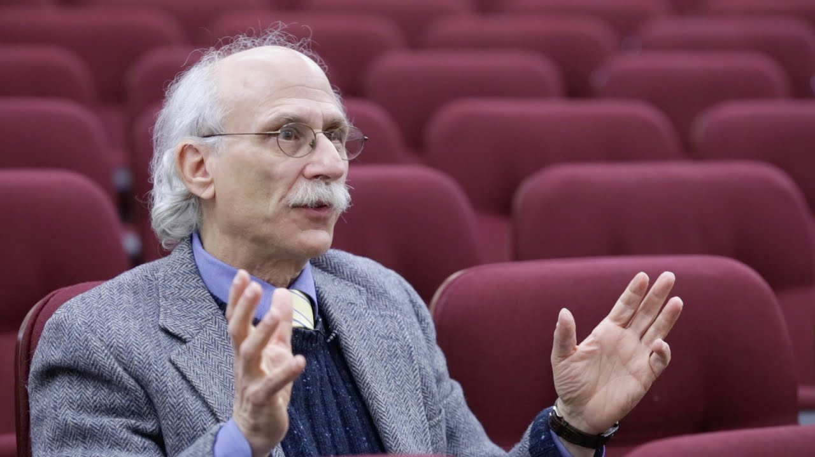

Digital Forum for Student Faculty Live Interaction
LearnScience from the Best
Faculty in the country.
> Live Lectures
> Live Doubt Clearing
> Attractive Pricing
> On Spot doubt clearance
> 3 Step Easy Appointment
Booking
> Free Study Material
> Premium Customised Notes

Slide 2
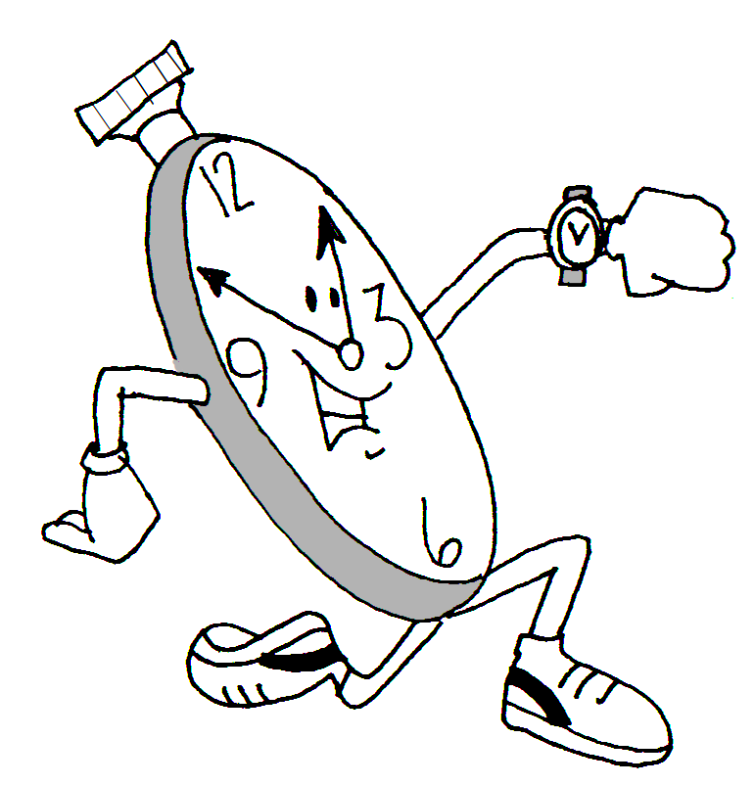
What Makes us Special:
We have Integrated Live Video Lecture Modules, with an immensive Teacher-Student Learning Whiteboard.
Solve Any doubt you wanna ask almost instantly.

Slide 3


Strengths:
Will Work on Low Bandwidth:
Realtime Doubt Clearance,
Even if you are watching Recorded Lecture in One Click.

Slide 4

Weakness:
Platform does not guarantee the sucess of students.
We will implement deap learning based on the quality of questions being asked by the students and appropriately grading him between (0-1)*100. This will be compares to 1000's of students on our platform.

Slide 5

Threats
We have done that, which these organization failed to do.
That's propostrous, as these companies charge heavily for certifications and nano degree.

Slide 6
Documentation:
Languages Used:
p5.js
Node js
socket.io 2.0

Slide 7
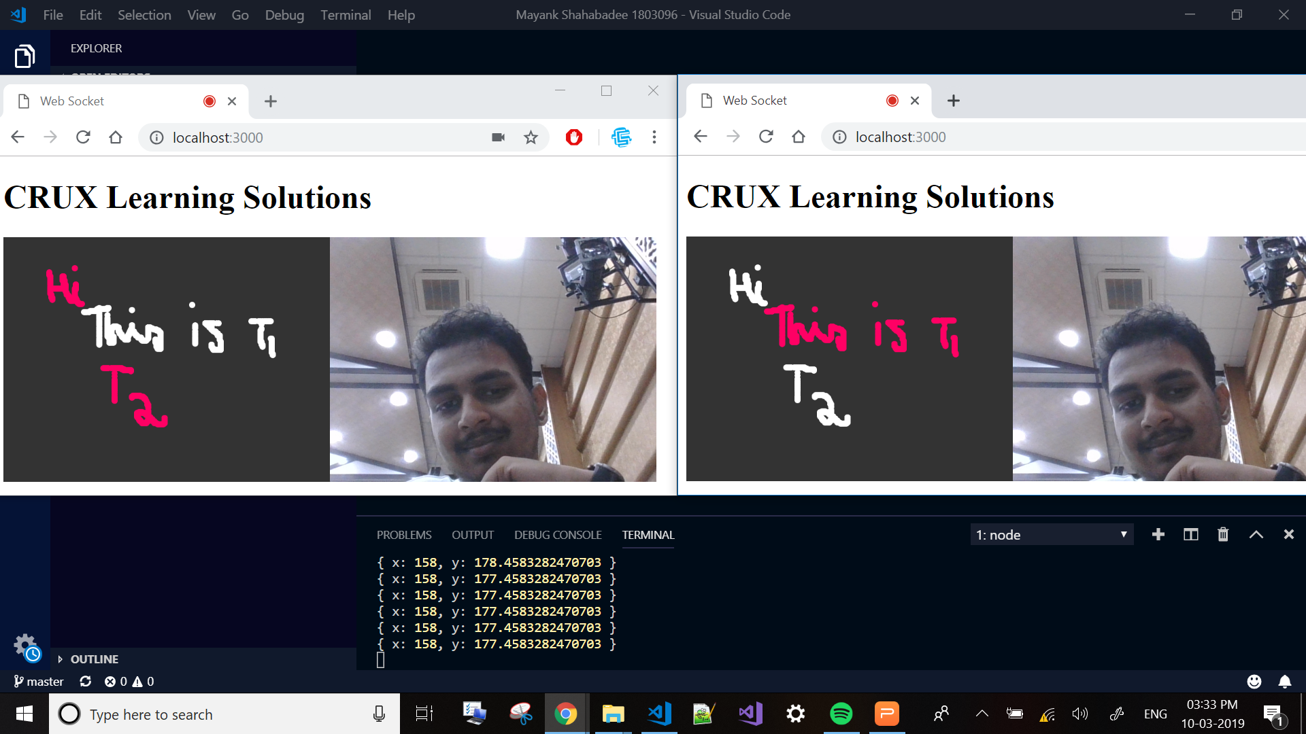

Slide 8
Thank You

